Slide 1
Basis
Hung-yi Lee

Slide 2
Outline
What is a basis for a subspace?
Confirming that a set is a basis for a subspace
Reference: Textbook 4.2

Slide 3
What is Basis?

Slide 4
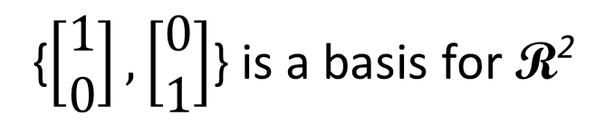
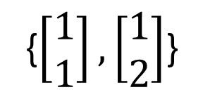
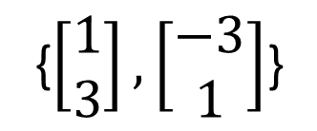
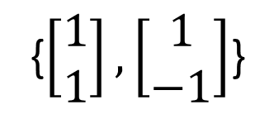
Basis
Why nonzero?
Let V be a nonzero subspace of R^{n}. A basis B for V is a linearly independent generation set of V.
{e₁, e₂, …, e_{n}} is a basis for R^{n}.
1. {e₁, e₂, …, e_{n}} is independent
2. {e₁, e₂, …, e_{n}} generates R^{n}.
{$\left[\begin{matrix}1 \\ 0\end{matrix}\right],\left[\begin{matrix}0 \\ 1\end{matrix}\right]$} is a basis for R²
{$\left[\begin{matrix}1 \\ 1\end{matrix}\right],\left[\begin{matrix}1 \\ −1\end{matrix}\right]$}
{$\left[\begin{matrix}1 \\ 3\end{matrix}\right],\left[\begin{matrix}−3 \\ 1\end{matrix}\right]$}
{$\left[\begin{matrix}1 \\ 1\end{matrix}\right],\left[\begin{matrix}1 \\ 2\end{matrix}\right]$}
…… any two independent vectors form a basis for R²
Notes:
(vector set)

Slide 5
Basis
The pivot columns of a matrix form a basis for its columns space.
RREF
pivot columns
Col A
= Span

Slide 6
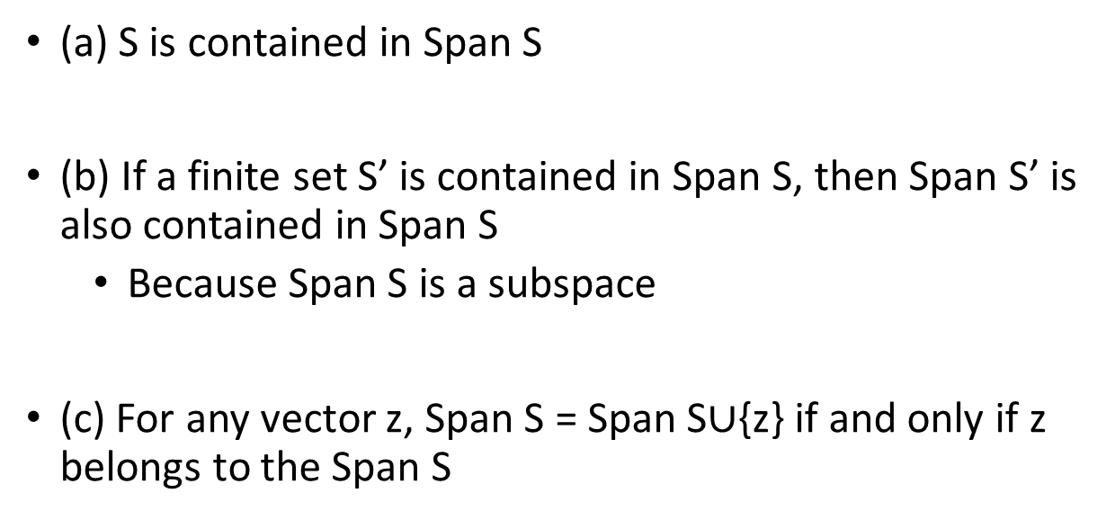
Property
Basis is always in its subspace
(a) S is contained in Span S
(b) If a finite set S’ is contained in Span S, then Span S’ is also contained in Span S
Because Span S is a subspace
(c) For any vector z, Span S = Span S$∪${z} if and only if z belongs to the Span S
Span S
Span S’
z
z

Slide 7
Theorem
1. A basis is the smallest generation set.
2. A basis is the largest independent vector set in the subspace.
3. Any two bases for a subspace contain the same number of vectors.
The number of vectors in a basis for a nonzero subspace V is called dimension of V (dim V).
Notes:
Basis is a vector set
When I say “large” or “small”, I mean the number of elelemtns in the set

Slide 8
Theorem 3
Textbook P245
Null B
Null C
Any two bases of a subspace V contain the same number of vectors
Suppose {u₁, u₂, …, u_{k}} and {w₁, w₂, …, w_{p}} are two bases of V.
Let A = [u₁ u₂ … u_{k}] and B = [w₁ w₂ … w_{p}].
Since {u₁, u₂, …, u_{k}} spans V, ∃ c_{i} ∈ R^{k} s.t. Ac_{i} = w_{i} for all i
⇒ A[c₁ c₂ … c_{p}] = [w₁ w₂ … w_{p}]
⇒ AC = B
Now Cx = 0 for some x ∈ R^{p}
⇒ ACx = Bx = 0
B is independent vector set
⇒ c₁ c₂ … c_{p} are independent
⇒ x= 0
c_{i} ∈ R^{k}
⇒ p ≤ k
Reversing the roles of the two bases one has k ≤ p ⇒ p = k.
Notes:
………………….

Slide 9
Theorem 3
Every basis of R^{n} has n vectors.
The number of vectors in a basis for a subspace V is called the dimension of V, and is denoted dim V
The dimension of zero subspace is 0
dim R² =2
dim R³=3
Notes:
Understand as how large your span is

Slide 10

Example
Find dim V
$$x_{1}=3x_{2}−5x_{3}+6x_{4}$$
dim V = 3
Basis?
Independent vector set that generates V

Slide 11
Theorem 1
A basis is the smallest generation set.
If there is a generation set S for subspace V,
The size of basis for V is smaller than or equal to S.
Reduction Theorem
There is a basis containing in any generation set S.
S can be reduced to a basis for V by removing some vectors.

Slide 12

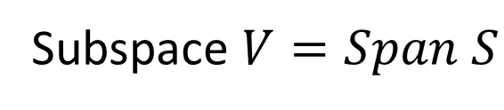
Theorem 1 – Reduction Theorem
所有的 generation set 心中都有一個 basis
S can be reduced to a basis for V by removing some vectors.
Suppose S = {u₁, u₂, …, u_{k}} is a generation set of subspace V
Subspace $V=Span S$
Let A = [ u₁ u₂ ☹ u_{k} ].
$$=Col A$$
The basis of Col A is the pivot columns of A
Subset of S

Slide 13
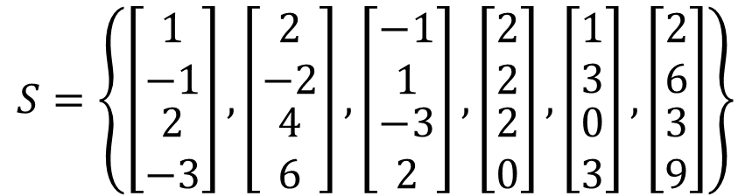
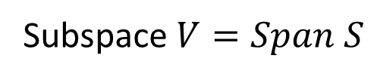


Theorem 1 – Reduction Theorem
所有的 generation set 心中都有一個 basis
Subspace $V=Span S$
$$=Col A$$
= Span
$$S=\left\{\left[\begin{matrix}\begin{matrix}1 \\ −1\end{matrix} \\ \begin{matrix}2 \\ −3\end{matrix}\end{matrix}\right],\left[\begin{matrix}\begin{matrix}2 \\ −2\end{matrix} \\ \begin{matrix}4 \\ 6\end{matrix}\end{matrix}\right],\left[\begin{matrix}\begin{matrix}−1 \\ 1\end{matrix} \\ \begin{matrix}−3 \\ 2\end{matrix}\end{matrix}\right],\left[\begin{matrix}\begin{matrix}2 \\ 2\end{matrix} \\ \begin{matrix}2 \\ 0\end{matrix}\end{matrix}\right],\left[\begin{matrix}\begin{matrix}1 \\ 3\end{matrix} \\ \begin{matrix}0 \\ 3\end{matrix}\end{matrix}\right],\left[\begin{matrix}\begin{matrix}2 \\ 6\end{matrix} \\ \begin{matrix}3 \\ 9\end{matrix}\end{matrix}\right]\right\}$$
Smallest generation set
Generation set
RREF
$$A=$$

Slide 14
Theorem 2
A basis is the largest independent set in the subspace.
If the size of basis is k, then you cannot find more than k independent vectors in the subspace.
Extension Theorem
Given an independent vector set S in the space
S can be extended to a basis by adding more vectors

Slide 15
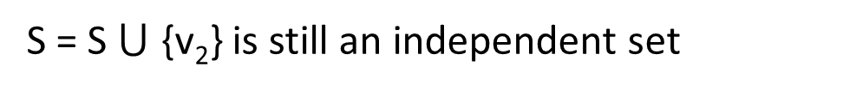
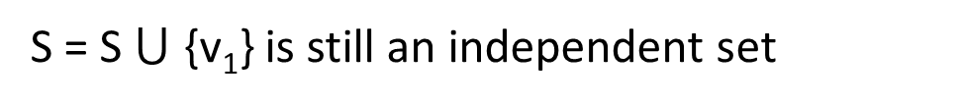
Theorem 2 – Extension Theorem
Independent set:
我不是一個 basis 就是正在成為一個 basis
There is a subspace V
Given a independent vector set S (elements of S are in V)
If Span S = V, then S is a basis
If Span S ≠ V, find v₁ in V, but not in Span S
S = S $⋃$ {v₁} is still an independent set
If Span S = V, then S is a basis
If Span S ≠ V, find v₂ in V, but not in Span S
S = S $⋃$ {v₂} is still an independent set
V
……
You will find the basis in the end.

Slide 16
More from Theorems
A basis is the smallest generation set.
A vector set generates R^{m} must contain at least m vectors.
R^{m} have a basis {e₁, e₂, …, e_{m}}
Because a basis is the smallest generation set
Any other generation set has at least m vectors.
A basis is the largest independent set in the subspace.
Any independent vector set in R^{m} contain at most m vectors.
Notes:
三神氣
三皇
三人形
Every subset of R^{n} with more than n vectors is L.D. (Section 1.7).
⇒ Every basis of R^{n} contains at most n vectors.
⇒ Every basis of R^{n} contains exactly n vectors.

Slide 17
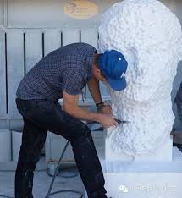
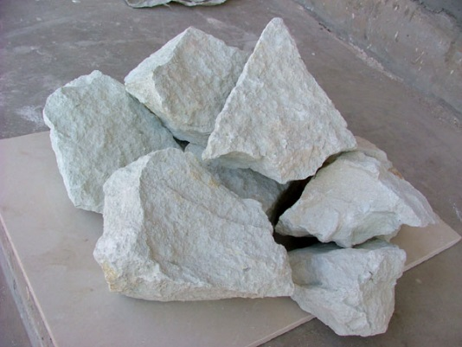
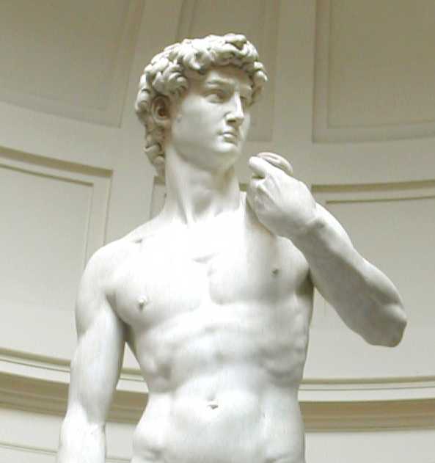
Summary
雕塑 … 主要是使用雕（通過減除材料來造型）及塑（通過疊加材料來造型）的方式 …… (from wiki)
Same size
刪去
疊加
Independent vector set
Generation set
Basis
Notes:
https://www.lightnovel.cn/thread-743816-1-1.html

Slide 18
Confirming that a set is a Basis

Slide 19
Intuitive Way
Definition: A basis B for V is an independent generation set of V.
Is C a basis of V ?
Independent?
yes
Generation set?
difficult
generates V

Slide 20
Another way
Find a basis for V
Given a subspace V, assume that we already know that dim V = k. Suppose S is a subset of V with k vectors
If S is independent
S is basis
If S is a generation set
S is basis
Dim V = 2
(parametric representation)
Is C a basis of V ?
C is a subset of V with 2 vectors
C is a basis of V
Independent?
yes
Notes:
本來要兩個
但已經 dim, 一個就夠了 ….

Slide 21
Another way
Assume that dim V = k. Suppose S is a subset of V with k vectors
If S is independent
S is basis
By the extension theorem, we can add more vector into S to form a basis.
However, S already have k vectors, so it is already a basis.
If S is a generation set
S is basis
By the reduction theorem, we can remove some vector from S to form a basis.
However, S already have k vectors, so it is already a basis.
Notes:
https://www.lightnovel.cn/thread-743816-1-1.html
Proof Let S ⊆ V be L.I. and have k vectors.
⇒ By the Extension Theorem, ∃ a basis B s.t. S ⊇ B.
⇒ B has k vectors, since dim. V = k.
⇒ B = S.
Let S ⊆ V be a generating set for V and have k vectors.
⇒ By the Reduction Theorem, ∃ a basis B ⊆ S.
⇒ B has k vectors, since dim. V = k.
⇒ B = S.

Slide 22
Example
Is B a basis of V ?
Independent set in V?
yes
Dim V = ?
3
B is a basis of V.

Slide 23




Example
B is a subset of V with 3 vectors
Is B a basis of V = Span S ?
$$R_{A}=\left[\begin{matrix}\begin{matrix}1 & 0 \\ 0 & 1\end{matrix} & \begin{matrix}0 & −2/3 \\ 0 & 1/3\end{matrix} \\ \begin{matrix}0 & 0 \\ 0 & 0\end{matrix} & \begin{matrix}1 & 2/3 \\ 0 & 0\end{matrix}\end{matrix}\right]$$
$$dimA=3$$
$$R_{B}=\left[\begin{matrix}\begin{matrix}1 & 0 & 0 \\ 0 & 1 & 0\end{matrix} \\ \begin{matrix}0 & 0 & 1 \\ 0 & 0 & 0\end{matrix}\end{matrix}\right]$$
$$Independent$$
B is a basis of V.
Notes:
Textbook is tedious ???
1. B ⊆ W (you check that rank A = rank [ A B ].)
2. B is L.I. (you check it).
3. dim. W = 3 (you check that rank A = 3.)
⇒ B is a basis of W.

